Slide 1
IT694 Computer Networks Week7 – Lec1
TCP Congestion

Slide 2
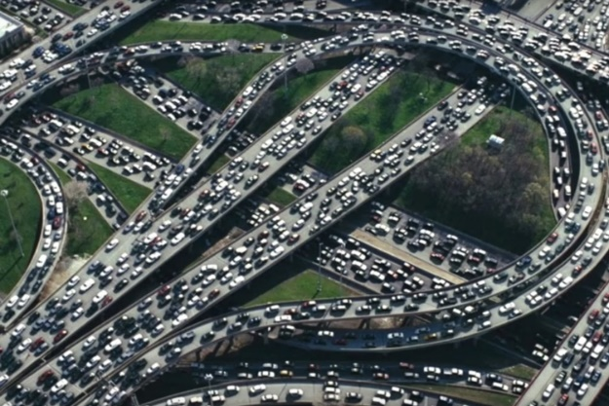
Principles of congestion control
Congestion:
informally: “too many sources sending too much data too fast for network to handle”
Sending rate limited by two FACTORS:
congestion control: too many senders, sending too fast
The first is flow control, in the case that there is insufficient buffering at the receiver.
The second is congestion, in the case that there is insufficient capacity in the network.

Slide 4

Causes of congestion: scenario I
original data: λ_{in}
throughput: λ_{out}
Simplest scenario:
Host A
one router, infinite buffers
input, output link capacity: R
infinite shared output link buffers
two flows
R
R
no retransmissions needed
Host B
R/2
Q: What happens as arrival rate λ_{in} approaches R/2?
λ_{out}
delay
throughput:
λ_{in}
R/2
λ_{in}
R/2
maximum per-connection throughput: R/2
large delays as arrival rate approaches capacity
λ_{in}
R/2

Slide 5
Cost of Congestion –Scenario I
throughput can never exceed capacity
delay increases as capacity approached

Slide 6

Causes of congestion: Scenario 2
one router, finite buffers
sender retransmits lost, timed-out packet
application-layer input = application-layer output: λ_{in} = λ_{out}
transport-layer input includes retransmissions : λ’_{in} λ_{in}
Host A
λ_{in} : original data
λ'_{in}: original data, plus retransmitted data
λ_{out}
R
R
Host B
finite shared output link buffers

Slide 7


Causes/costs of congestion: scenario 2a
Realistic scenario: un-needed duplicates
packets can be lost, dropped at router due to full buffers – requiring retransmissions
Host A
λ_{in} : original data
copy
λ'_{in}: original data, plus retransmitted data
timeout
free buffer space!
R
R
Host B
finite shared output link buffers

Slide 8
Causes/costs of congestion: scenario 2b
Realistic scenario: un-needed duplicates
but sender times can time out prematurely, sending two copies, both of which are delivered
R/2
λ_{out}
“wasted” capacity due to un-needed retransmissions
throughput:
when sending at R/2, some packets are retransmissions, including needed and un-needed duplicates, that are delivered!
Host A
λ_{in} : original data
λ_{in}
copy
λ'_{in}: original data, plus retransmitted data
R/2
timeout
free buffer space!
R
R
Host B
finite shared output link buffers

Slide 9
Causes/costs of congestion: insights
loss/retransmission decreases effective throughput
un-needed duplicates further decreases effective throughput
Each packet forwarded TWICE by the router

Slide 10
Causes/costs of congestion: scenario 3
four senders
multi-hop paths
timeout/retransmit
Q: what happens as λ_{in} and λ_{in}’ increase ?
A: as red λ_{in}’ increases, all arriving blue pkts at upper queue are dropped, blue throughput g 0
Host A
λ_{in} : original data
λ'_{in}: original data, plus retransmitted data
Host B
finite shared output link buffers
Host D
λ_{out}
Host C

Slide 11
Costs of congestion: scenario 3
R/2
λ_{out}
λ_{in}’
R/2
another “cost” of congestion:
when packet dropped, any upstream transmission capacity and buffering used for that packet was wasted!
Example of congestion

